Slide 1


Data Structures and Algorithms
SUYASH GUPTA – RA2211003010167
ABEL GEORGE WILSON – RA22113010182
MAANAS SOMANATHAN- RA2211003010185

Slide 2
Table of contents :
Objective
Problem statement
Implementation of 1st data type
Implementation of 2nd data type
Results
conclusion

Slide 3
Objective :
The objective of the code for real-time sensor data management is to provide a structured and efficient way to handle data generated by sensors in real-time applications, such as those found in the Internet of Things (IoT) or industrial automation.
The code provided for real-time sensor data management should align with these objectives and meet the specific requirements of the application, taking into account factors such as the type of sensors used, data volume, and the specific needs of the real-time system. It should offer an efficient and organized way to handle and make use of sensor data for real-time applications.

Slide 4

Problem statement :Real-Time Sensor Data Management
In an IoT system, sensors continuously collect and transmit real-time data. Your task is to develop a data structure to efficiently manage this data stream in a real-time application. The data includes sensor readings with a timestamp and value. You need to insert new readings into the data structure, retrieve data for analysis, and remove outdated data based on a specified time window.

Slide 5
Implementation of 1st Data Structure :
Array Implementation:
In this approach, you can use a dynamic array to store sensor readings. New readings are added to the end of the array, and when a reading is removed due to reaching the time window, you shift the elements to maintain the chronological order.
Time Complexity for Array Implementation:
Insertion of a new reading: O(1) on average for appending to the end of the array.
Retrieval of data within a time window: O(n), where n is the number of readings.
Removal of outdated data: O(n), as you may need to shift elements.

Slide 6
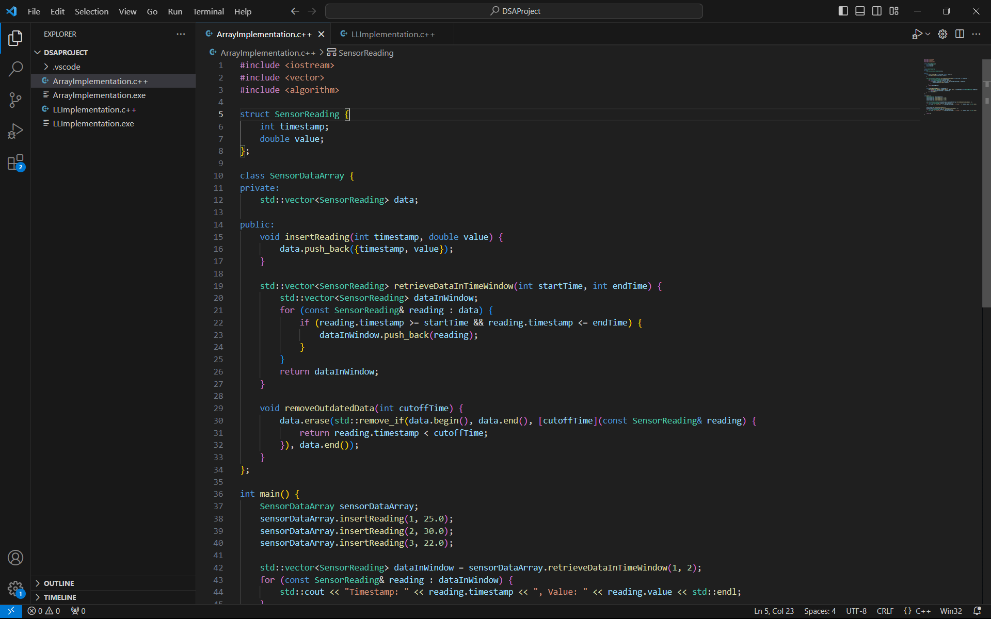

Slide 7
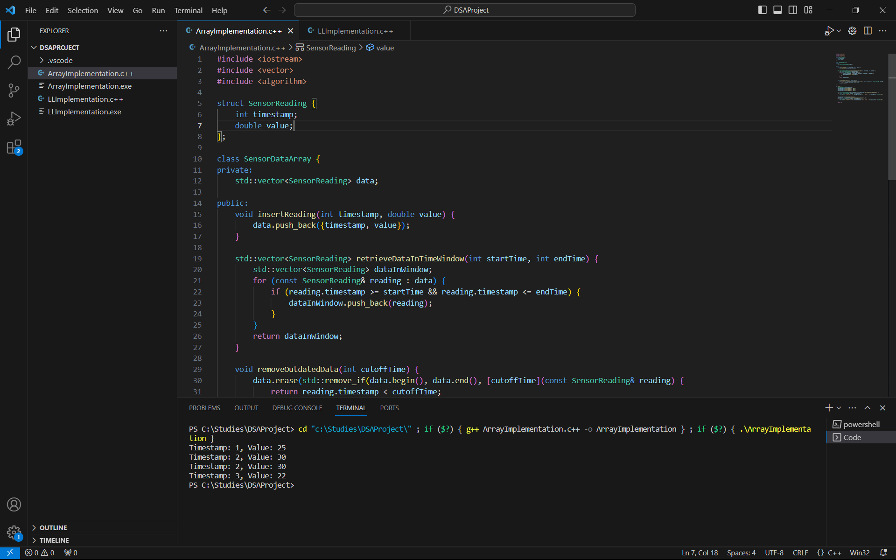

Slide 8
Implementation of 2nd Data Structure :
Linked List Implementation:
In this approach, you can use a singly linked list to store sensor readings. New readings are added to the head of the list, which simplifies insertion. When removing outdated data, you can traverse the list to identify and remove the outdated readings.
Time Complexity for Linked List Implementation:
Insertion of a new reading: O(1) as you simply update the head of the list.
Retrieval of data within a time window: O(n), where n is the number of readings, as you may
need to traverse the list.
Removal of outdated data: O(n), as you may need to traverse the list to remove outdated readings.

Slide 9
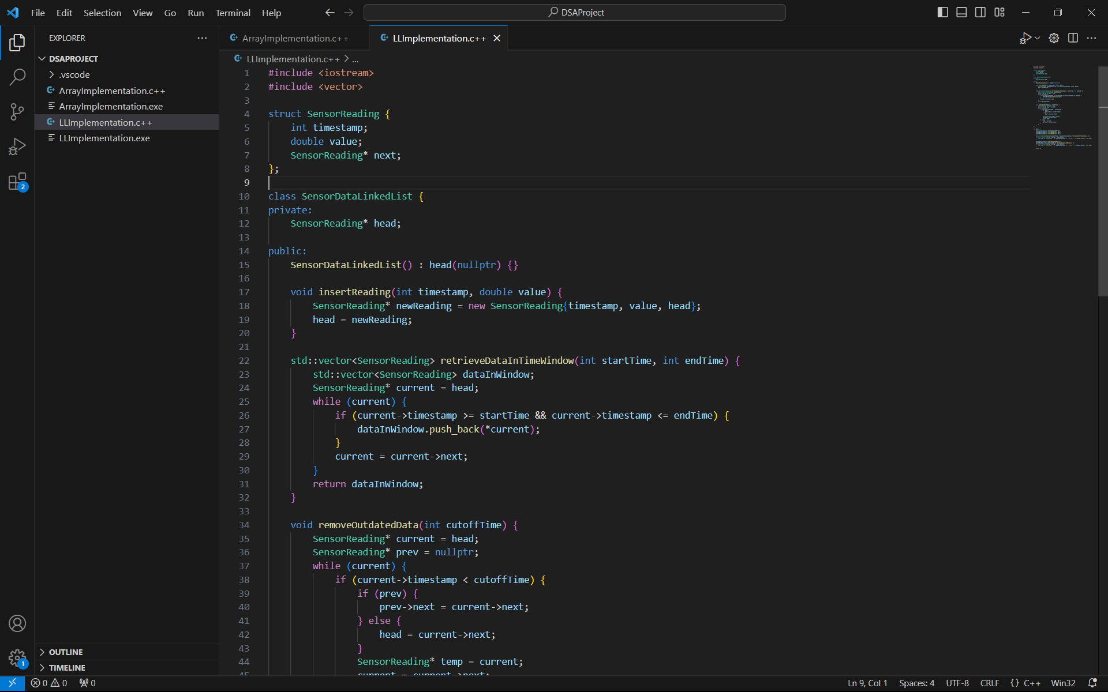

Slide 10
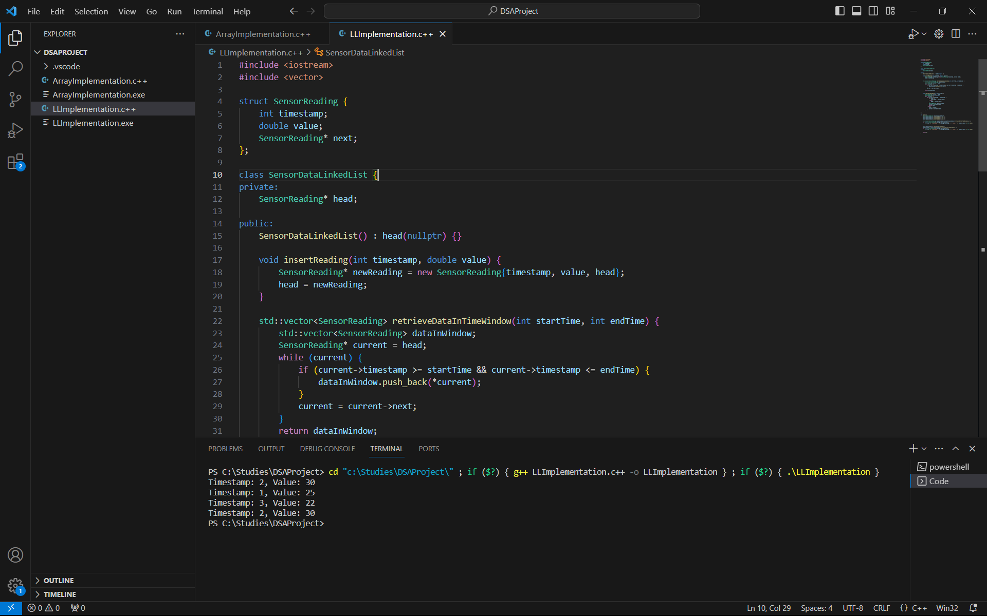

Slide 11
Results :
Both the array and linked list implementations have similar time complexities for insertion and data retrieval.
However, the array implementation may have slightly worse time complexity for removal as it requires shifting elements
Given the similar time complexities and considering the requirement to efficiently remove outdated data, the linked list may be the better choice for managing real-time sensor data, as it simplifies insertion and removal operations. Moreover, a circular buffer with a linked list can further optimize the data structure for this specific problem, making it a strong candidate.

Slide 12
Conclusion :
The choice between array and linked list data structures in real-world applications depends on the specific requirements of the application. Arrays are excellent for direct access to elements and are well-suited for static collections, while linked lists are valuable for dynamic datasets with frequent modifications. Additionally, optimizations like circular buffers can provide even more efficiency in certain scenarios. Ultimately, the best data structure depends on the unique demands of the real-world application.

